Slide 1
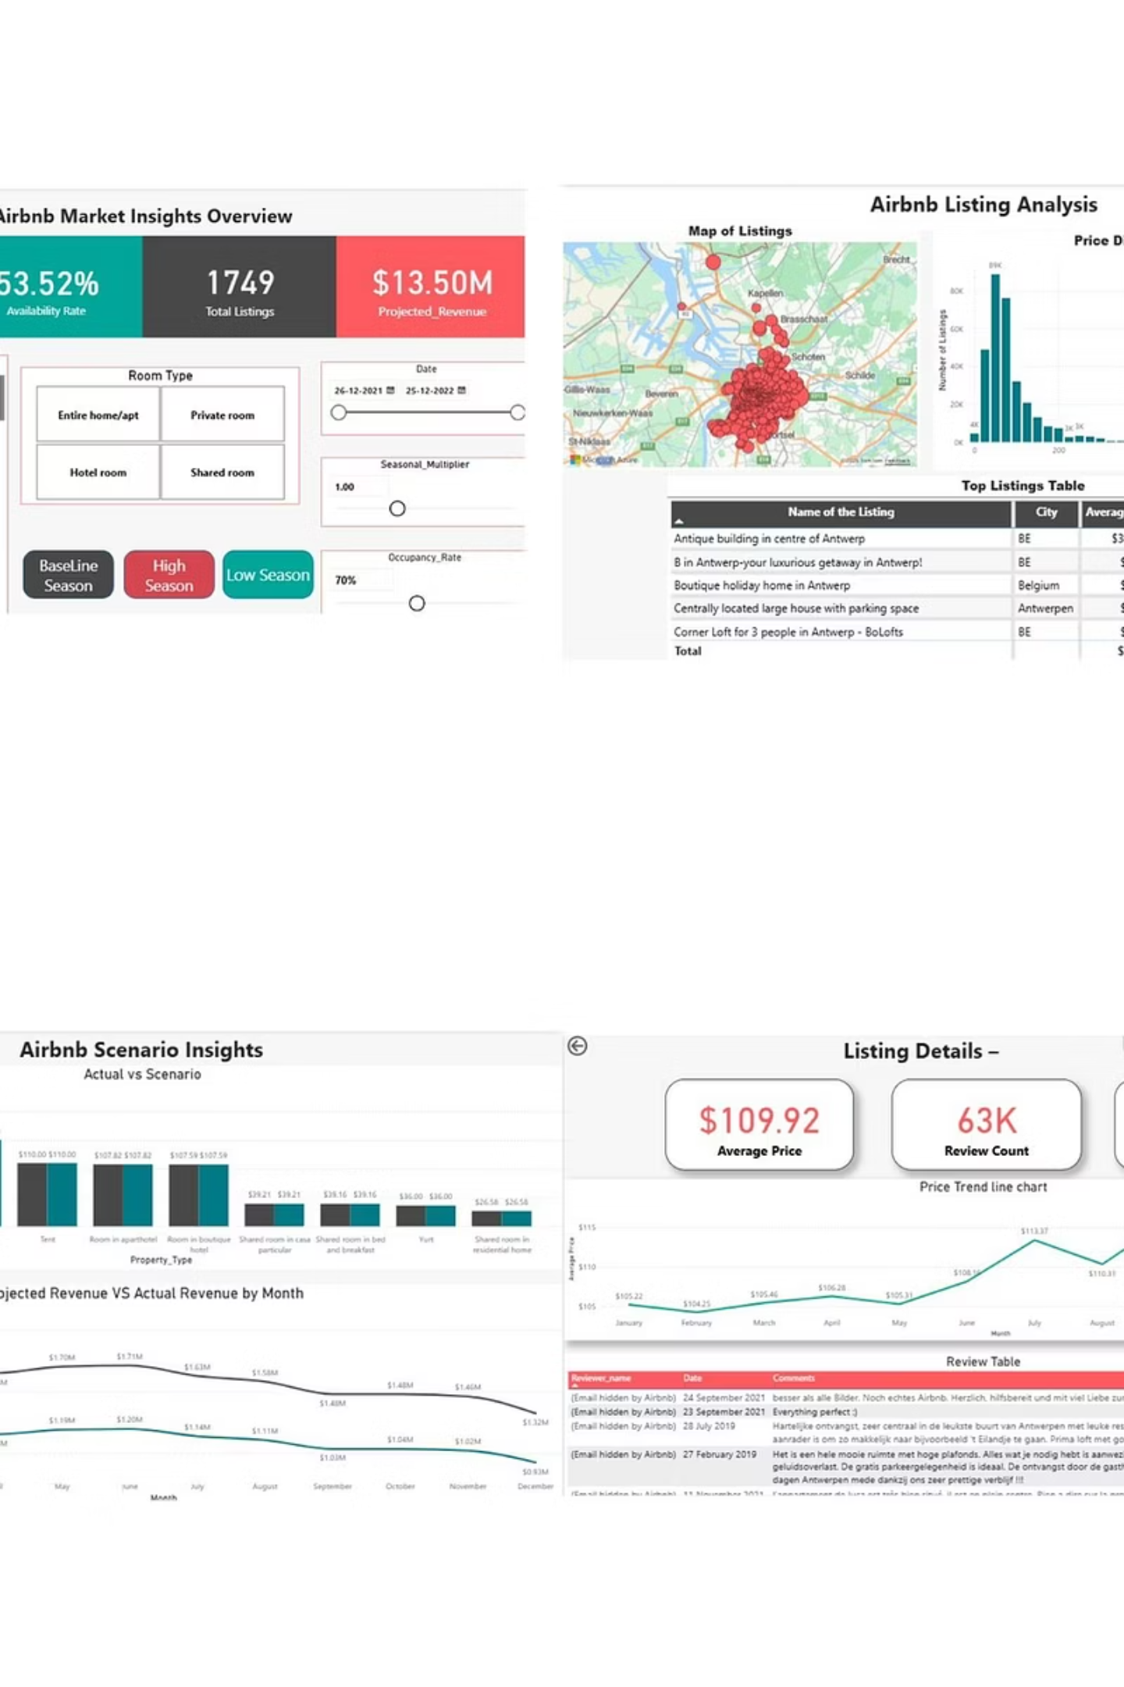
Airbnb Dashboard User Guide
Complete documentation for navigating and utilizing the Airbnb Market Insights Dashboard for data-driven decision making.
Prepared By:
Vikranth Singh
Chinta Dileep Chandra
Rohit Sharma
Mohammed Suhail
Nikitta Nataraj
Priyanka

Slide 2
Dashboard Navigation Overview
Market Insights
Listing Analysis
Overview of Airbnb market trends and performance metrics across regions.
Detailed analysis dashboard for individual property performance tracking.
Scenario Insights
Listing Details
What-if analysis tools for revenue projections and market scenarios.
Comprehensive property information with tooltip summaries for quick insights.

Slide 3
Interactive Controls Guide
01
02
Date Selection
Regional Filtering
Use the date slicer to select your analysis period from earliest to latest available dates.
Apply region and listing slicers to filter visuals for specific geographic areas or properties.
03
04
Scenario Adjustment
Interactive Exploration
Use occupancy and seasonal sliders to adjust projected revenue scenarios dynamically.
Hover on histograms or maps to see listing counts and names. Click any listing to open detailed drillthrough pages.

Slide 4
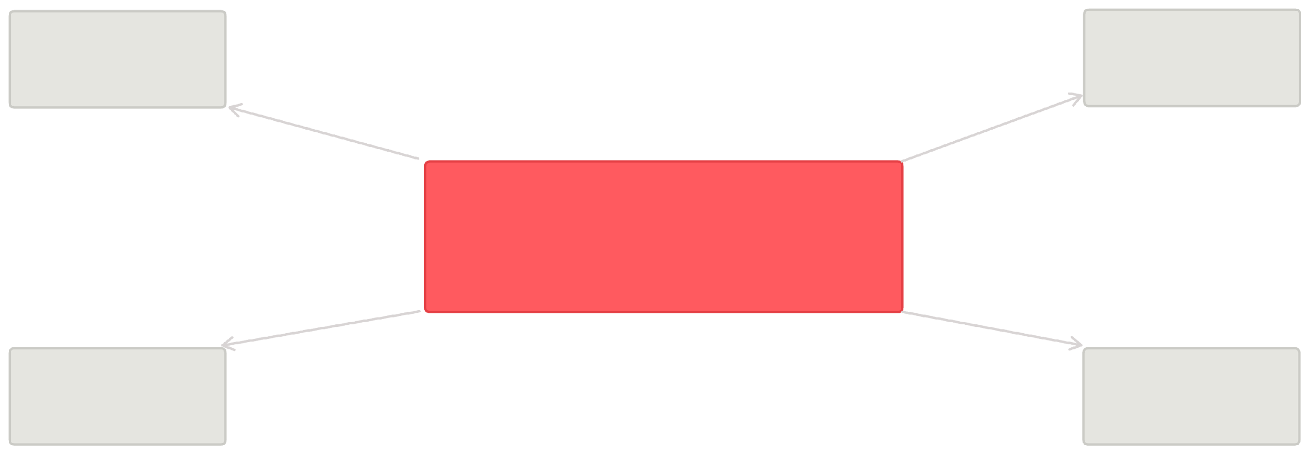
Data Model Architecture
Core Tables
Key Relationships
Calendar: Daily listing data with pricing and availability
Tables are connected through listing_id as the primary key, enabling comprehensive cross-table analysis and reporting capabilities.
Listings: Property metadata and regional information
Reviews: Customer feedback and rating scores
Calendar (Dimensions)
Hosts (Dimensions)
Listings (Fact)
Reviews (Dimensions)
Date (Dimensions)

Slide 5
Essential DAX Measures
Baseline Revenue
Projected Revenue
SUM('calendar'[adjusted_price])
Baseline × Occupancy × Seasonal
Calculates total revenue without any parameter adjustments for baseline analysis.
Dynamic revenue calculation incorporating what-if parameters for scenario planning.
Availability Rate
Average Price
Days available ÷ total days
AVERAGE('calendar'[adjusted_price])
Percentage of days a property is available for booking within the selected period.
Mean pricing across all listings for comparative market analysis.

Slide 6
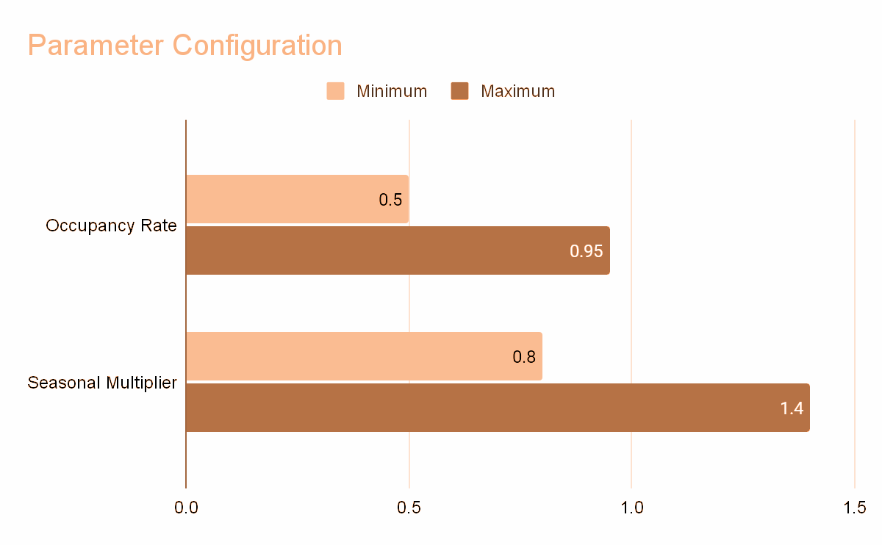
What-If Parameter Configuration
Adjust these parameters to model different market scenarios and revenue projections for strategic planning.

Slide 7
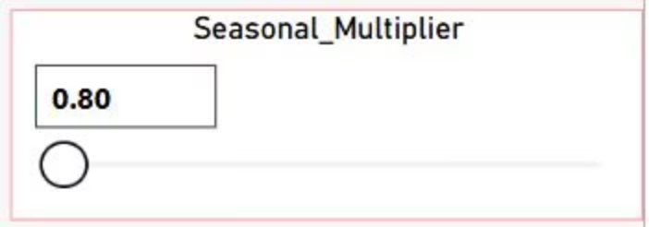
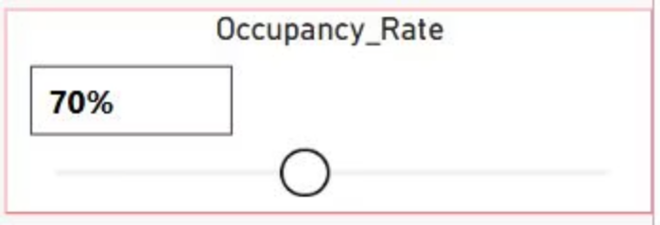
Parameter Controls Interface
Occupancy Rate Slider
Seasonal Multiplier
Adjust expected occupancy from 50% to 95% to model different booking scenarios.
Modify seasonal impact from 0.8x to 1.4x to account for peak and off-season variations.

Slide 8
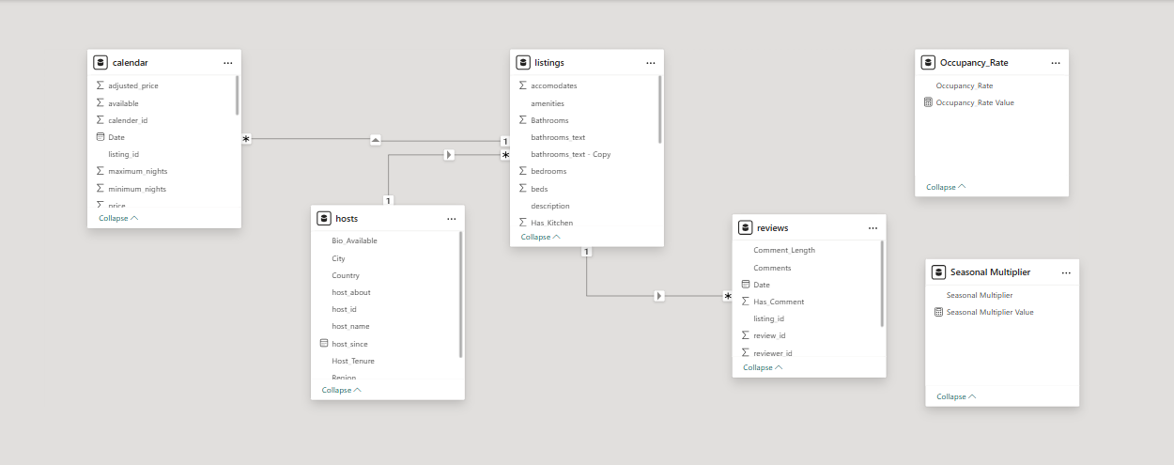
Data Model Relationships
The data model connects three core tables through listing_id relationships, enabling comprehensive analysis across calendar data, listing metadata, and review information.

Slide 9

Key Data Assumptions
Clean Dataset
All data has been validated with no null values present in critical fields.
Daily Granularity
Calendar data operates at daily level - no monthly aggregation required for analysis.
Tooltip Optimization
When multiple listings exist in one visualization bar, tooltips display sample listing names for clarity.

Slide 10



Best Practices for Analysis
Time Period Selection
Regional Filtering
Scenario Modeling
Start with broader date ranges to identify trends, then narrow focus for detailed analysis of specific periods.
Compare similar regions or property types to identify performance patterns and market opportunities.
Test multiple occupancy and seasonal scenarios to understand revenue sensitivity and risk factors.

Slide 11





Getting Started Checklist
Access Dashboard
Log into Power BI using the provided URL and verify all pages load correctly.
Configure Filters
Set your preferred date range and regional filters for initial analysis scope.
Test Parameters
Experiment with occupancy and seasonal sliders to understand their impact on projections.
Explore Interactivity
Practice hovering and clicking on visualizations to access detailed information and drillthrough pages.

